Slide 1
Jungle presentation 3 – Class/sequence diagrams, game demo
The ‘C’ Team:
Jake Marrapode
Ian Franklin
Braiden Wells
Saloni Choudhary

Slide 2
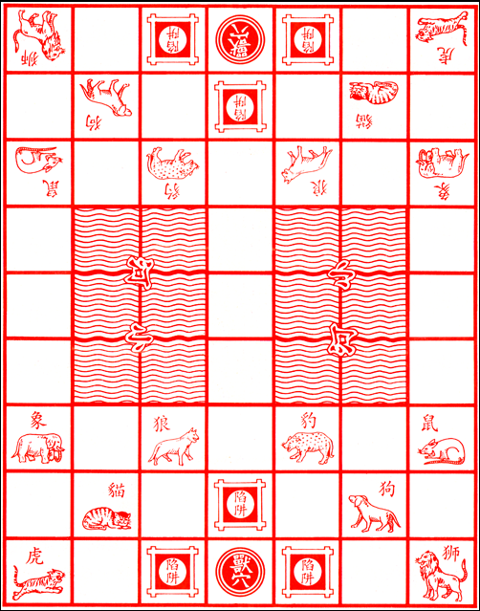
Jungle Game Review
Two players
8 movable pieces per player:
Rat, Cat Wolf, Dog, Leopard, Tiger, Lion, Elephant
Pieces can remove a weaker piece – strength is the listed order
3 Traps per player
Traps remove an opposing player’s piece and are destroyed
1 Den (Objective) per player
Game ends when the den of one player captures another's den
Two rivers that can be crossed only with certain pieces

Slide 3
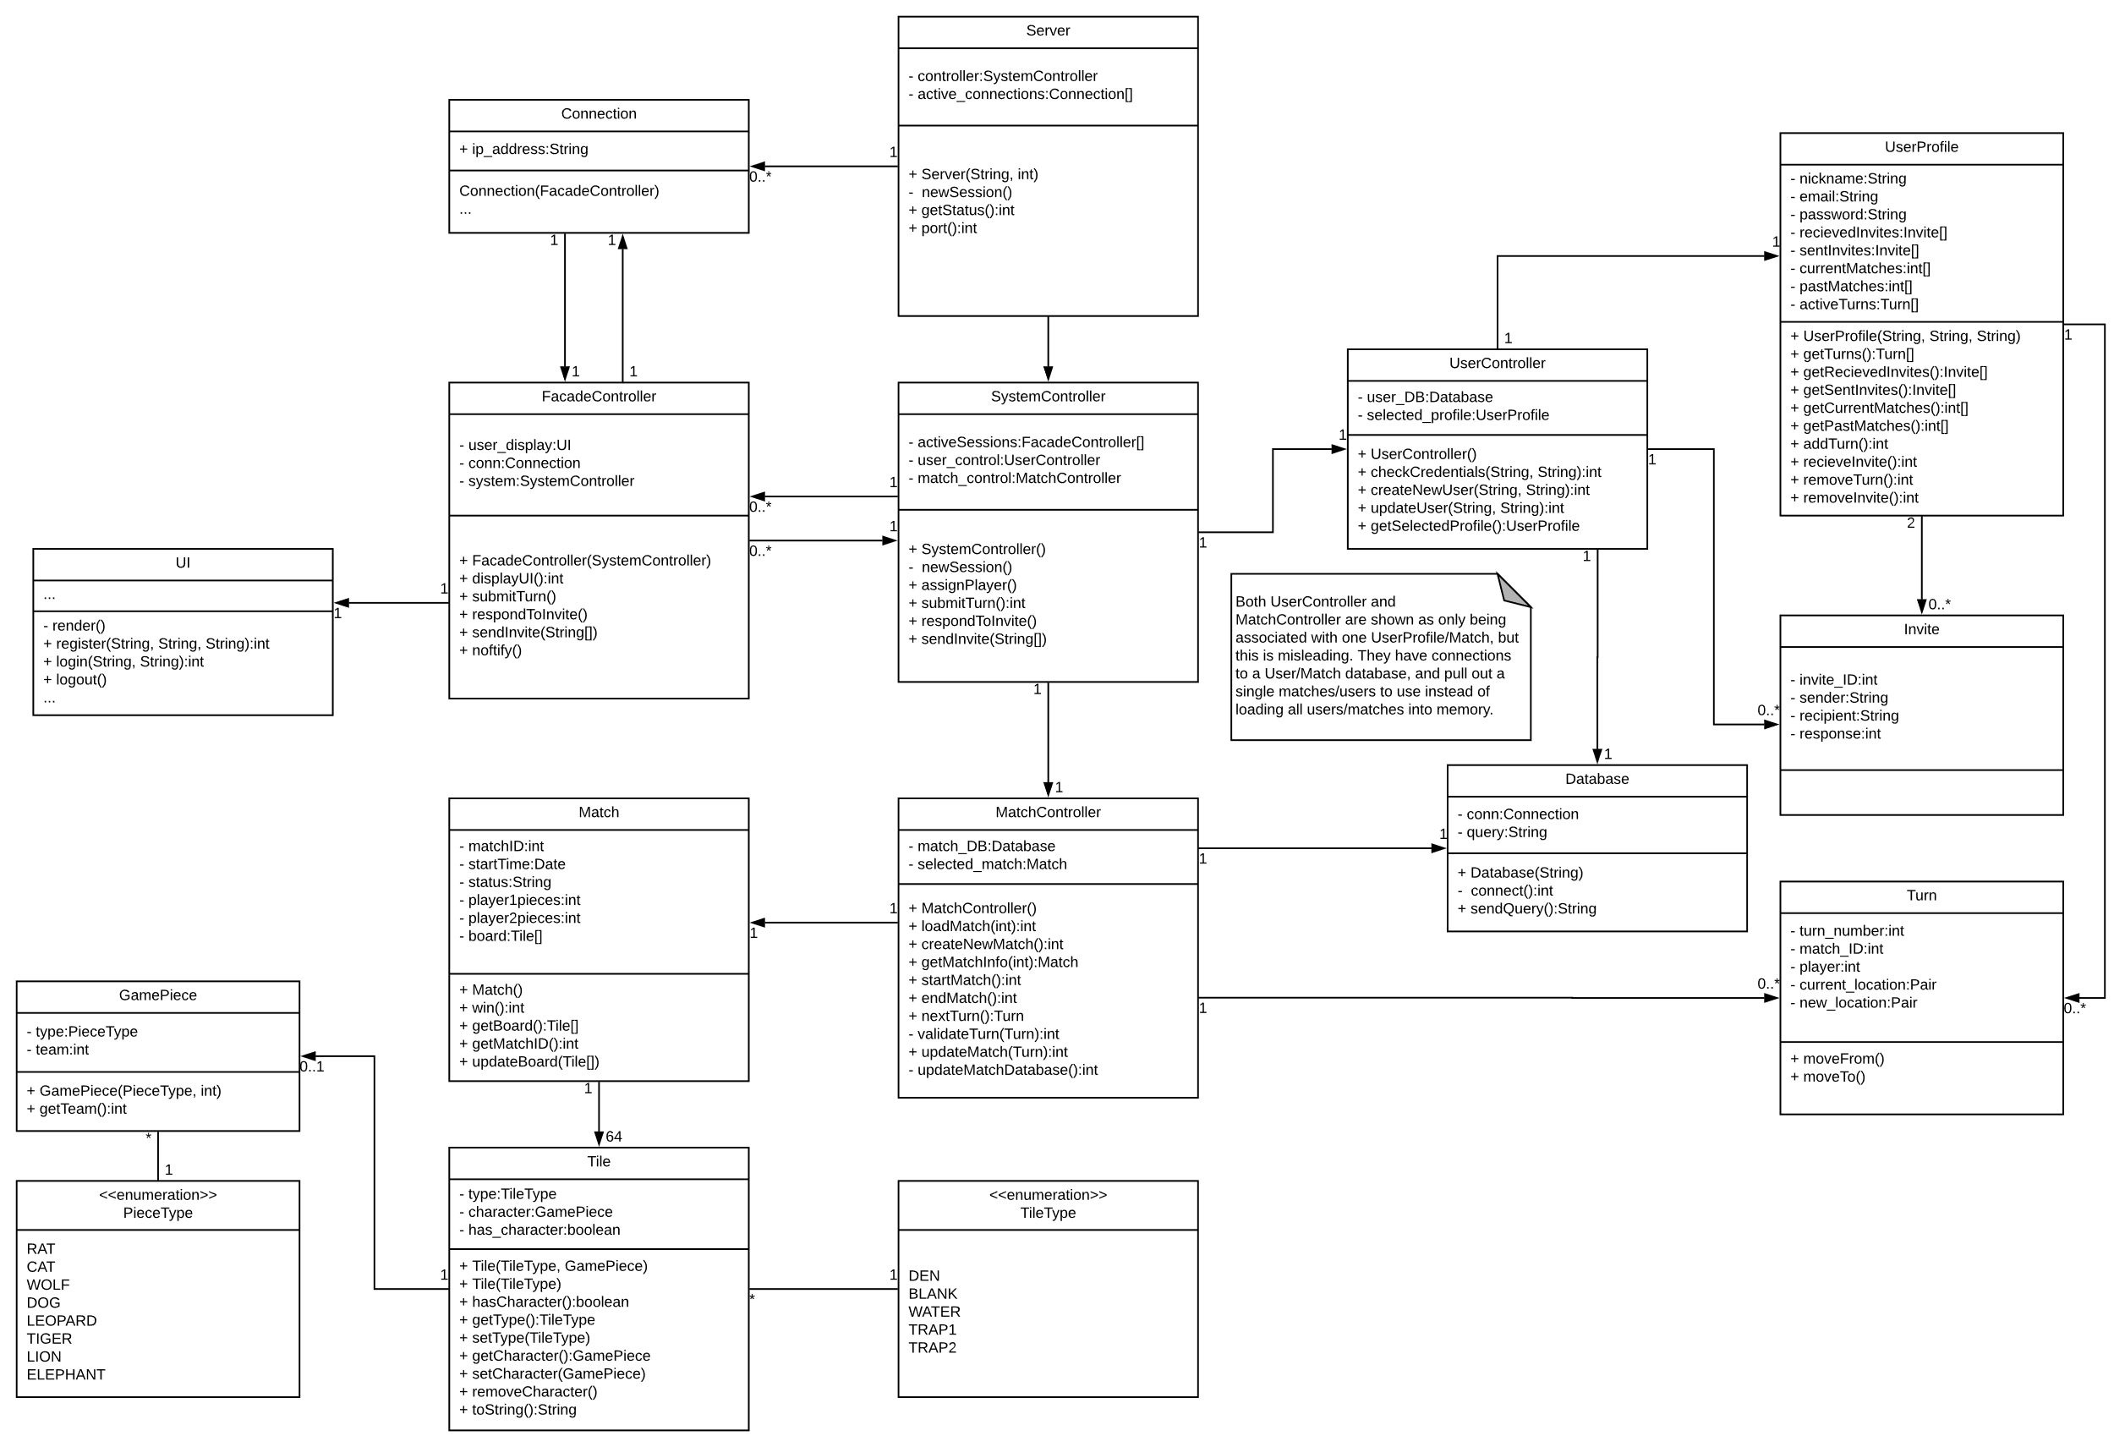
Class diagram

Slide 4
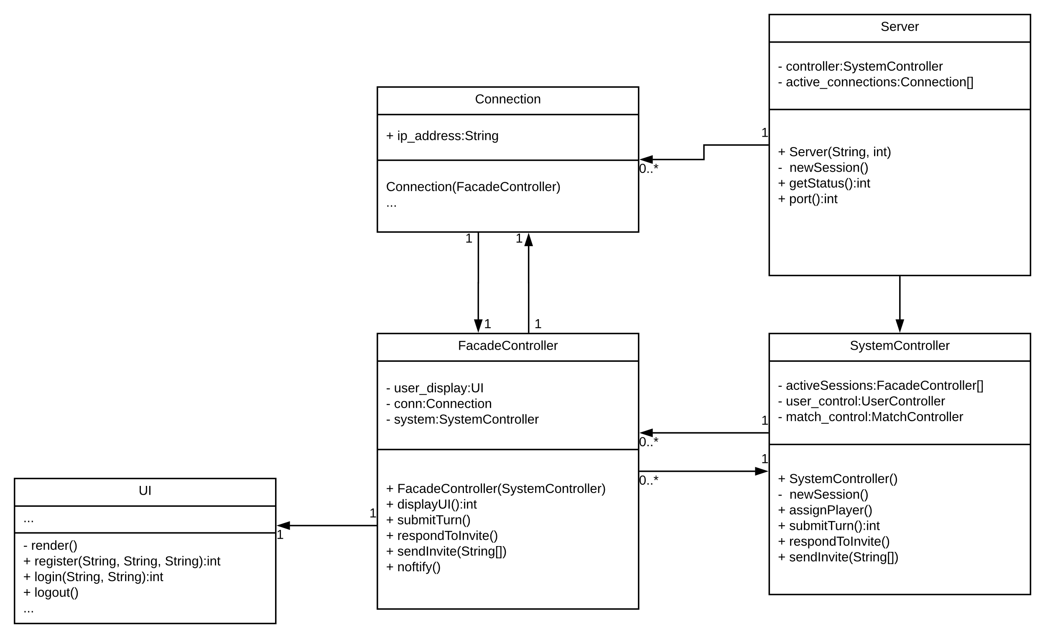
Class diagram

Slide 5
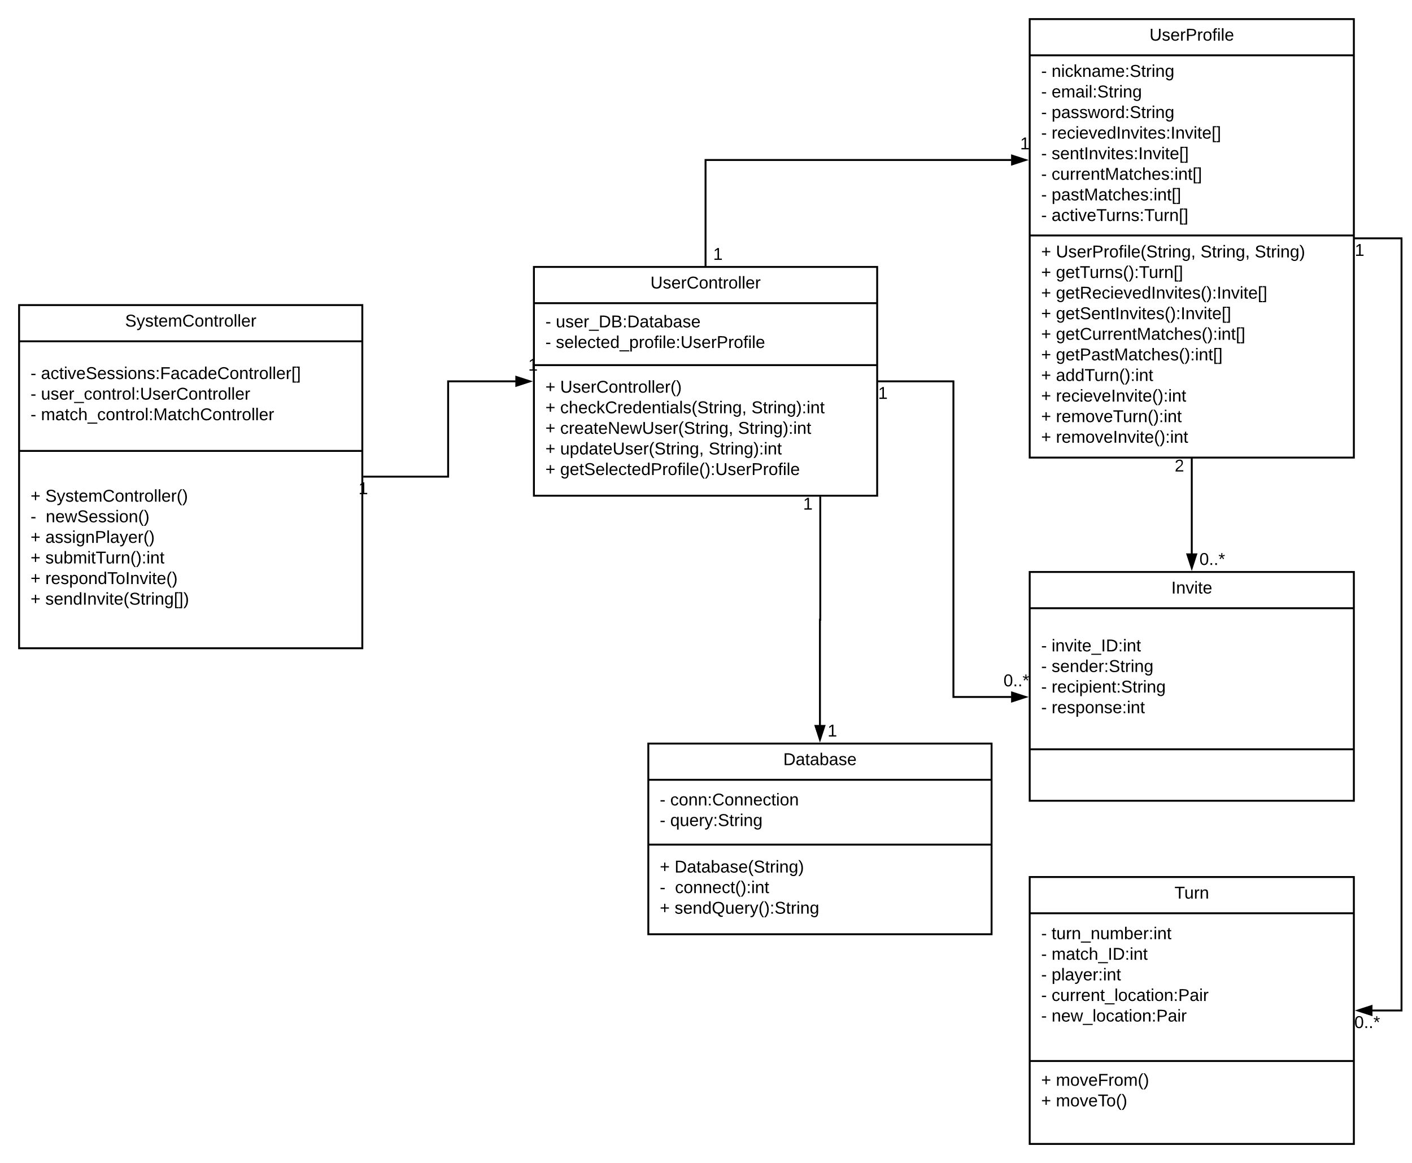
Class diagram

Slide 6
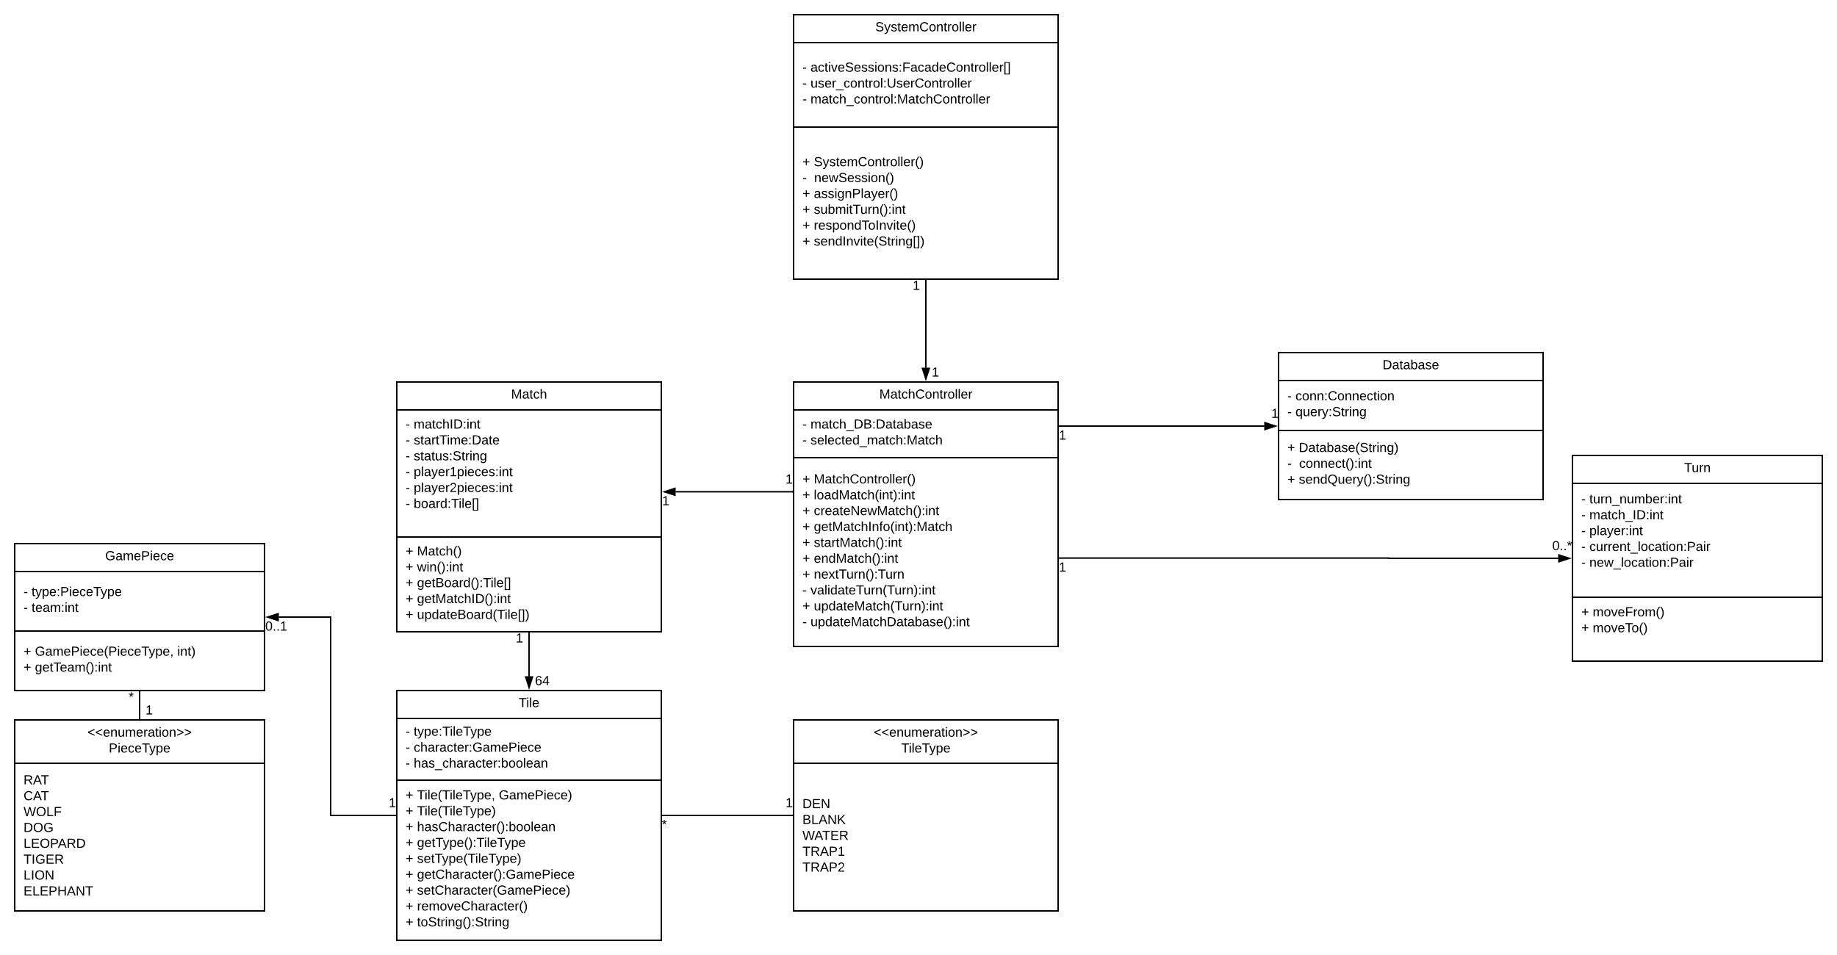
Class diagram

Slide 7
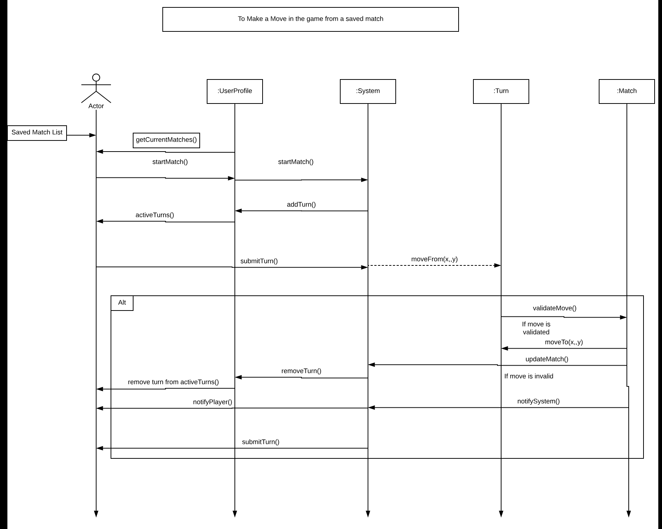
Sequence diagram: turn/Move

Slide 8
Game logic demo

